Slide 1
Cache & CPU Performance
Huỳnh Ngọc Thi
so61pi.re@gmail.com

Slide 2
Agenda
Questions
What is cache?
Why CPU needs cache?
How does cache work?
Cache line & MESI protocol
False sharing
Answer questions
Recommendations
Demo

Slide 3
Questions – #1
Which one is faster?
int matrix[R][C] = {0};
int sum = 0;
// row-major // column-major
for (int r = 0; r < R; ++r) for (int c = 0; c < C; ++c)
for (int c = 0; c < C; ++c) for (int r = 0; r < R; ++r)
sum += matrix[r][c]; sum += matrix[r][c];

Slide 4
Questions – #2
Which one is faster?
std::vector<int> v(BIG);
std::forward_list<int> l(BIG);
auto va = std::accumulate(begin(v), end(v), 0);
auto la = std::accumulate(begin(l), end(l), 0);

Slide 5
Questions – #3
How many cycles does the CPU consume to execute this code?
mov eax, dword ptr [0x12345678]

Slide 6
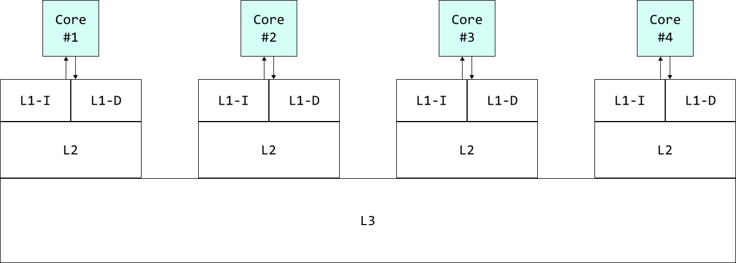
What is cache?
Cache is small high speed memory usually Static RAM (SRAM) that contains the most recently accessed pieces of main memory.
From: http://download.intel.com/design/intarch/papers/cache6.pdf

Slide 7
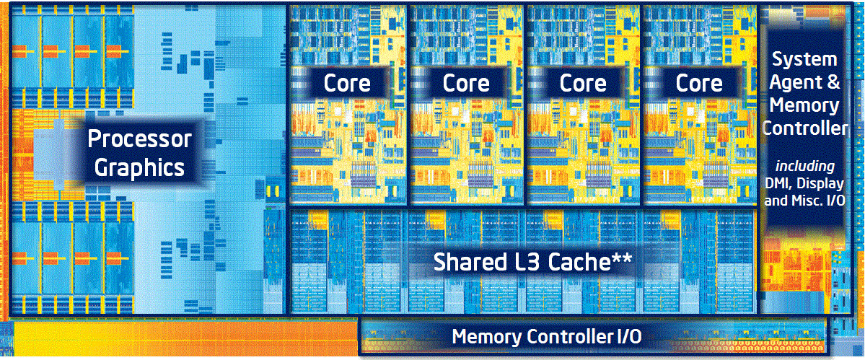
What is cache?
L1-I: 32K
L1-D: 32K
L2: 256K
L3: 8M
Ivy-Bridge Die
Notes:
From: http://www.anandtech.com/show/5771/the-intel-ivy-bridge-core-i7-3770k-review/3

Slide 8
Why CPU needs cache?
A trip to RAM takes a very long time.
Latency CoreSpeed = 2.5GHz
L1 – 4 cycles 1.6 ns
L2 – 12 cycles 4.8 ns
L3 – 26-31 cycles 10.4-12.4 ns
L2 & L1 in other cores
Clean hit – 43 cycles 17.2 ns
Dirty hit – 60 cycles 24 ns
Main memory – 100 ns
From: Intel Optimization Reference Manual + internet.

Slide 9
How does cache work – Read
Cache-hit
Requested data is currently in the cache.
Returned back to CPU quickly.
Cache-miss
Requested data is not in the cache.
Must be loaded from RAM (a long trip).
Lookup rule (Intel processors)
L1 – D
L2
L3
L1 & L2 in other cores
RAM

Slide 10
How does cache work – Write
Write-back
Cache acts like a buffer.
Data is written to cache, then transferred to RAM later.
Usually comes with write-allocate.
Write-allocate: Data at the missed-write location is loaded to cache.
Write-through
Data is written immediately to RAM.
Usually comes with write-no-allocate.
Write-no-allocate: Data at the missed-write location is not loaded to cache.
Intel processors use write-back policy.

Slide 11
Cache line
Program tends to use adjacent data.
local variables.
array elements.
A trip to RAM will load a cache line.
A cache line is 64 bytes, aligned.

Slide 12
MESI protocol
Each cache line has one of the following states:
Exclusive
Set when only one Core has the cache line & it’s clean.
Shared
Set when more than one core has the cache line & it’s clean.
Modified
Set when a write to the cache line happens, makes it dirty.
Invalid
Set when one of the cores writes to a Shared cache line.

Slide 13
False sharing
struct { int x; int y; } f;
void core_1() { int core_2() {
for (int i = 0; i++ < 100;) int s = 0;
++f.x; for (int i = 0; i++ < 100;)
} s += f.y;
}

Slide 14
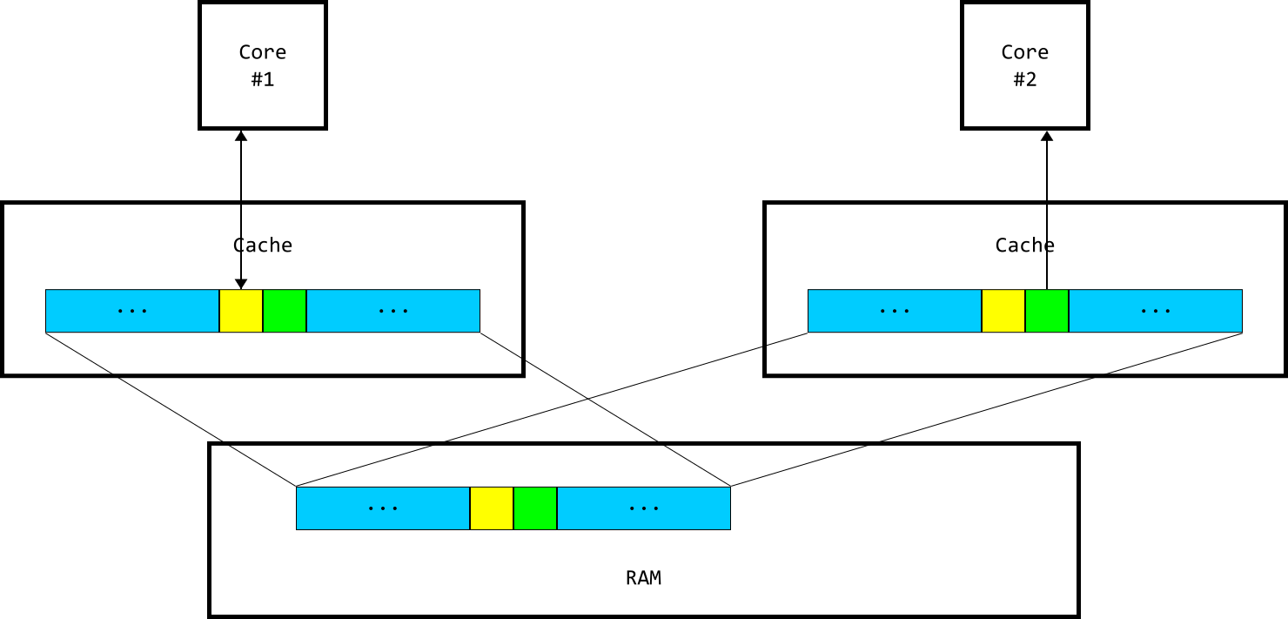
False sharing
Notes:
To ensure data consistency across multiple caches, multiprocessor-capable Intel® processors follow the MESI (Modified/Exclusive/Shared/Invalid) protocol. On first load of a cache line, the processor will mark the cache line as ‘Exclusive’ access. As long as the cache line is marked exclusive, subsequent loads are free to use the existing data in cache. If the processor sees the same cache line loaded by another processor on the bus, it marks the cache line with ‘Shared’ access. If the processor stores a cache line marked as ‘S’, the cache line is marked as ‘Modified’ and all other processors are sent an ‘Invalid’ cache line message. If the processor sees the same cache line which is now marked ‘M’ being accessed by another processor, the processor stores the cache line back to memory and marks its cache line as ‘Shared’. The other processor that is accessing the same cache line incurs a cache miss.
From: https://software.intel.com/en-us/articles/avoiding-and-identifying-false-sharing-among-threads

Slide 15
Answer questions – #1
Which one is faster?
int matrix[R][C] = {0};
int sum = 0;
// row-major // column-major
for (int r = 0; r < R; ++r) for (int c = 0; c < C; ++c)
for (int c = 0; c < C; ++c) for (int r = 0; r < R; ++r)
sum += matrix[r][c]; sum += matrix[r][c];

Slide 16
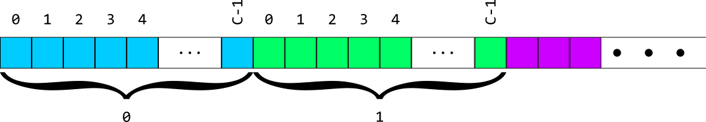
Answer questions – #1
Memory layout of matrix
Row-major order traversal uses cache line better.
Column-major’s creates more cache misses.

Slide 17
Answer questions – #2
Which one is faster?
std::vector<int> v(BIG);
std::forward_list<int> l(BIG);
auto va = std::accumulate(begin(v), end(v), 0);
auto la = std::accumulate(begin(l), end(l), 0);

Slide 18
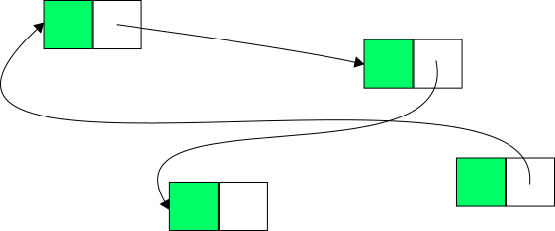
Answer questions – #2
std::vector memory layout
std::forward_list memory layout
std::vector uses cache line better.
std::forward_list creates more cache misses.

Slide 19
Answer questions – #3
How many cycles does the CPU consume to execute this code?
mov eax, dword ptr [0x12345678]
It depends on whether the data @ 0x12345678 is currently in cache.

Slide 20
Recommendations
Use array-based data structure (std::vector, std::array, plain array).
Arrange frequently used data close to each other.
Avoid false sharing.
Smaller is faster.

Slide 21
Demo

Slide 22
Thanks for listening! Questions?

